Slide 1
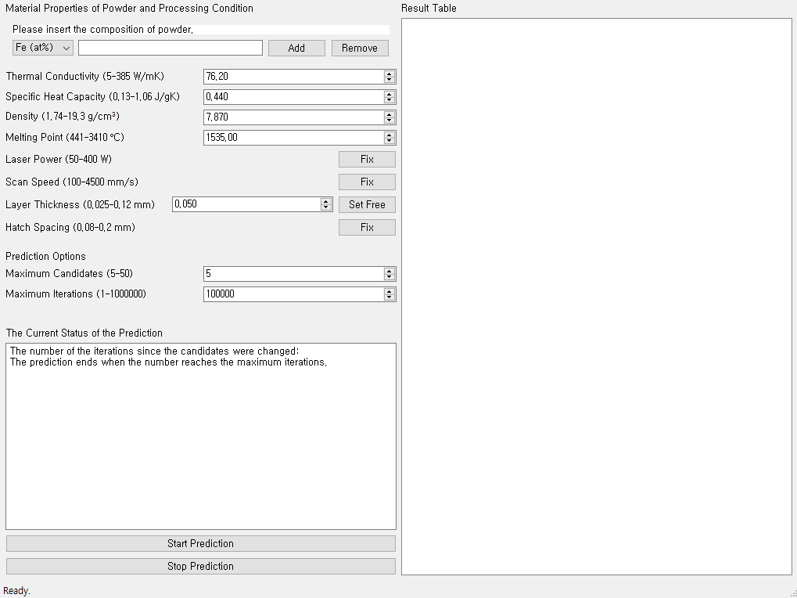
To add the atomic percent of the element, click ‘Add’ button after editing the 2 boxes to the left.
To remove the atomic percent of the element, click ‘Remove’ button after editing the leftmost box.
The result will be shown in here after the prediction is over or stopped by clicking ‘Stop Prediction’ button.
Material Properties are available in “Alloy data.xlsx” file
To fix the value of the process parameter, click ‘Fix’ button
This means the maximum number of process conditions that will appear on output.
To set free the value of the process parameter, click ‘Set Free’ button
After adding and editing above, click this button to start prediction.
This button immediately stops the prediction process and shows the best results so far.

